Slide 1
CIECA Product Simplification
Improving product utilization and member Engagement

Slide 2
Objectives
Increase Member Engagement
Improve the usability and adoption of CIECA Standards
Make CIECA Standards easy to understand… easy to use…

Slide 3
Industry / Member Feedback
Industry / member feedback is that the BMS is complex / overwhelming
The naming / components of the BMS are not clear to new users
What is the BMS?
A standard?
A document?
A data dictionary?

Slide 4
Business Challenge
Adoption: If the product isn’t easy to use, developers won’t use it.
Developer Engagement: If they don’t use the product, they won’t engage in CIECA.
Standards Feedback: If they won’t engage with CIECA, we won’t receive feedback about what needs to be updated.
Member Engagement: If our products aren’t up-to-date, they aren’t relevant and soon, neither is CIECA.

Slide 5
Product Simplification Concept
The first step in driving developer, member and board engagement is offering products people want to use.
When products are complex, people cherry-pick the parts they understand and ignore the rest.
Complex products aren’t fun or easy to work with and don’t inspire a developer community that wants to make it better.
We need to simplify and standardize the structure and naming convention of CIECA Standards so they are easy to use.

Slide 6
Product Home Page Concept
Develop a standardized home page for each CIECA message.
Clearly identify the common elements of each message
Use Case: What, when, who and why we use the message
Data Dictionary: Definitions of the data elements included in the standard
Code List: Listing of all the variables / codes included in a standard
Clearly identify the elements of each message that may vary by product
Schema: Structure & organization of the data elements
Implementation Guide: Examples and FAQs for implementing
Test Instances: Verified code for negative and positive testing

Slide 7
Assignment Message Services
Common Elements (All Assignment Messages)
Use Case
Message Specific (Assignment Add Request)
Schema
Data Dictionary
Code Lists
Implementation Guide
Test Instances
BMS / CAPIS
BMS / CAPIS
BMS / CAPIS

Slide 8
Recommendation
Change naming / references so that BMS is only a product name and not a document or an element of a standard.
Develop a standard set of terms to define the parts of a standard:
Use Case
Data Dictionary
Code List
Schema
Implementation Guide
Test Instances
Develop a Product home page for each Message Service.
Use a standardized template for each Product home page so they are predictable and easy to use.
Enable users to easily navigate to any related content from the Product home page.

Slide 9
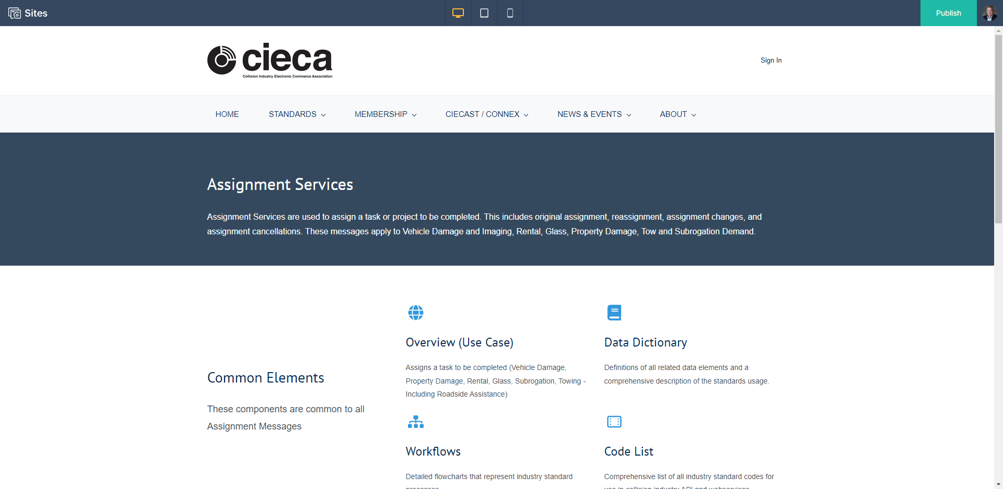
Assignment Services Homepage

Slide 10
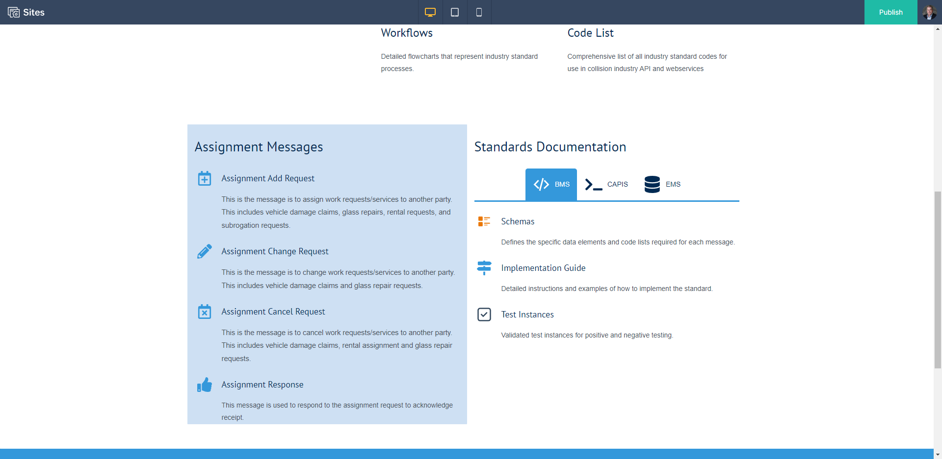
Assignment Services Homepage

Slide 11
Assignment Services Home Page

Slide 12
Assignment Services Home Page

